Slide 1
House Sales Price Prediction with Machine Learning
Dr Carmen Su

Slide 2
Contents
Fundamental Concepts
Data Preprocessing
Learning (& Prediction)
Evaluation
References

Slide 3

Fundamental Concepts
Input (x)
Output (y)
$$y=Wx+b$$
Model
Machine Learning
Supervised Learning
Unsupervised Learning
Reinforcement Learning

Slide 4
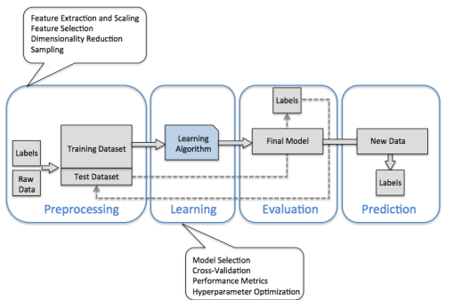
Supervised Learning Workflow

Slide 5
Data Prepocessing

Slide 6
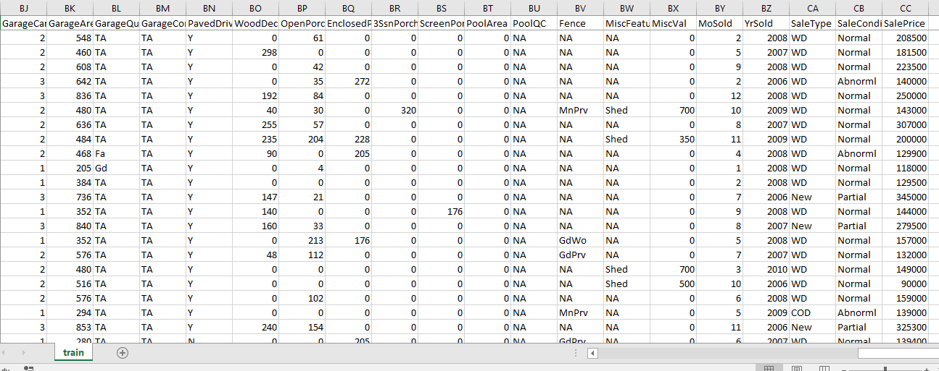

Data Preprocess
Preprocess the data into the format which can be processed in machine learning models
Exam the data (https://www.kaggle.com/c/house-prices-advanced-regression-techniques/data)
Label
$$y=Wx+b$$
Features
Categorical
Numerical
Missing
Label

Slide 7
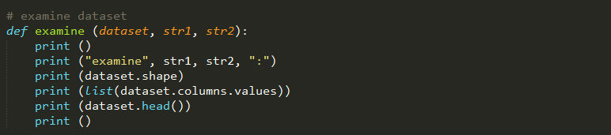
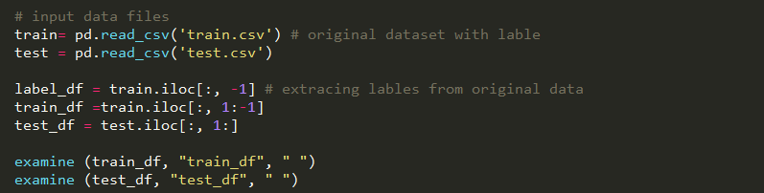
Examine Data

Slide 8
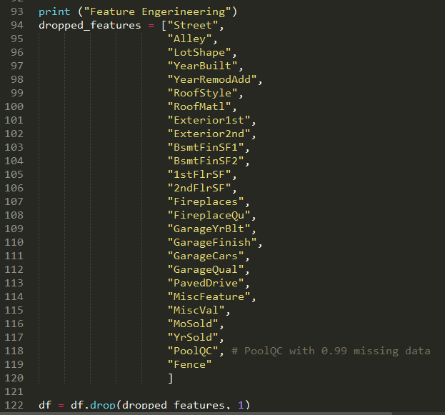
Data Cleansing – Feature Engineering

Slide 9
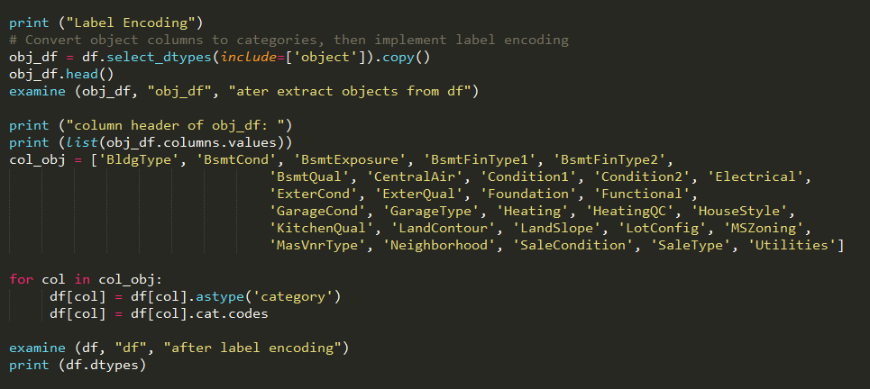
Data Cleansing – Categorical Values

Slide 10
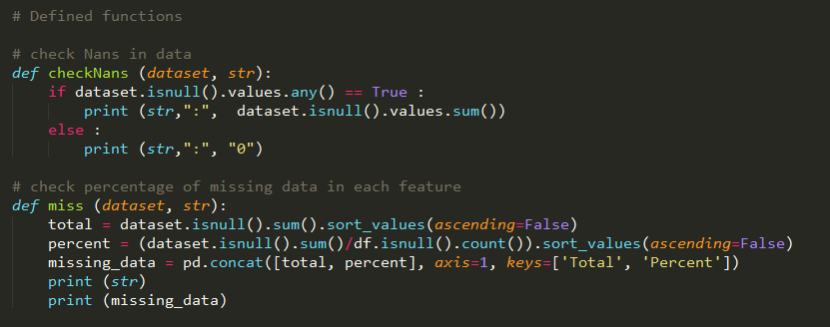
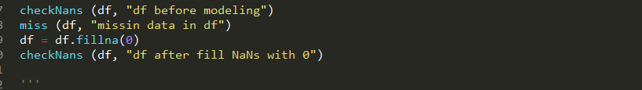
Data Cleansing – Missing Values

Slide 11
Learning (& Prediction)

Slide 12
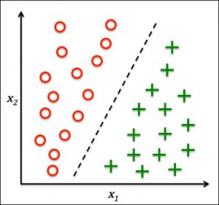
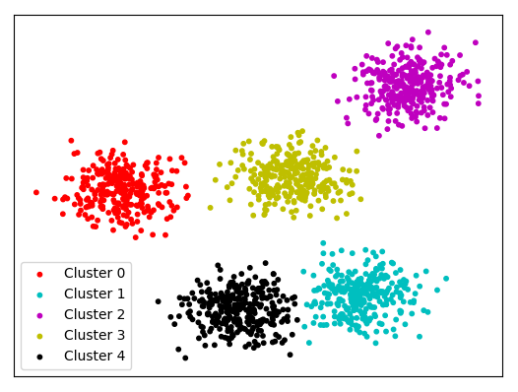
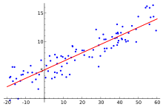
User Case Identification
What we try to predict
What type of data
Regression, classification or clustering

Slide 13
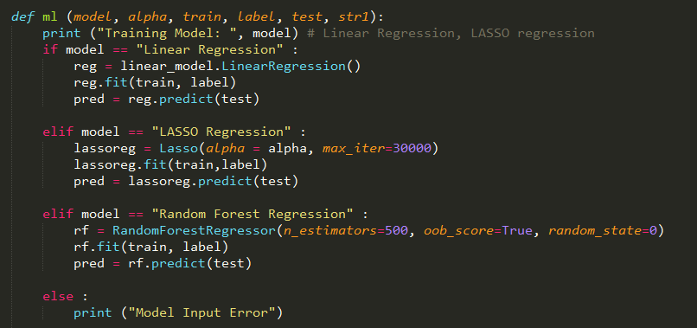
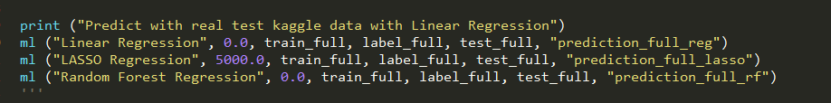
Model Selection

Slide 14
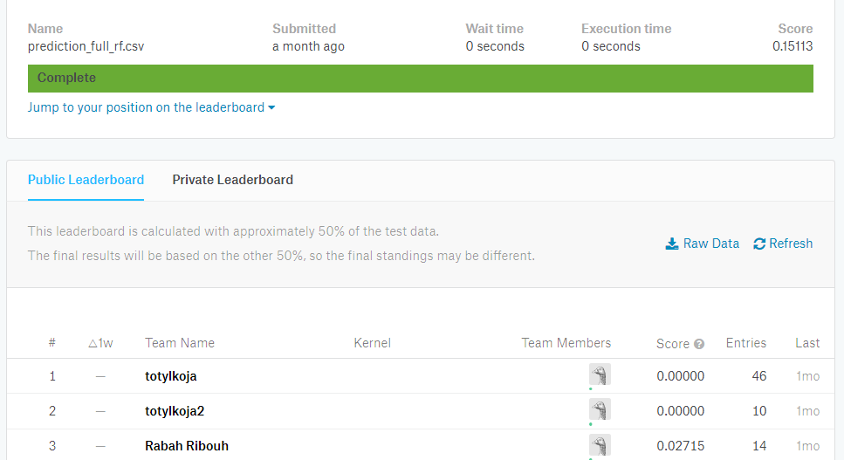
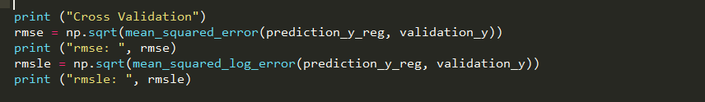
Evaluation

Slide 15
References
Python Machine Learning by Sebastian Raschka
https://www.kaggle.com/c/house-prices-advanced-regression-techniques
https://pandas.pydata.org/pandas-docs/stable/
https://docs.scipy.org/doc/
http://scikit-learn.org/stable/index.html

